Slide 1
Test Automation Framework
By - Abhijit Das

Slide 2
Basic Flow
Driver Script Initiation
Scripts Execution
Results Generation
Summary Report
e-mail Report

Slide 3
Architecture
Object Repository
Driver Script
Controller File
Application Library
Script 1
Script 2
Script N
Common Library
Test Data 1
Test Data 2
Test Data N
Report Library
Test Result 1
Test Result 2
Test Result N
Test Summary Report

Slide 4
Features Implemented
Selective Script Run
Browser Compatibility
Environment Based
Property Validation
Executive Summary
Auto E-Mailer
Screen Shot
Desired script is executed by changing the Execute column in controller excel file value to yes.
Tested in Chrome and IE.
Individual script is executed by changing the Environment column value to ‘DEV’ , ‘SIT’ , ‘UAT’ accordingly.
Does not require code change; changing the values in property field sheet will suffice.
A summarized report of all the test case along with dynamically generated Pie chart visualization.
After the execution completes, the Executive summary is emailed to listed email id.
Capture’s the screenshot of failed scenarios.

Slide 5
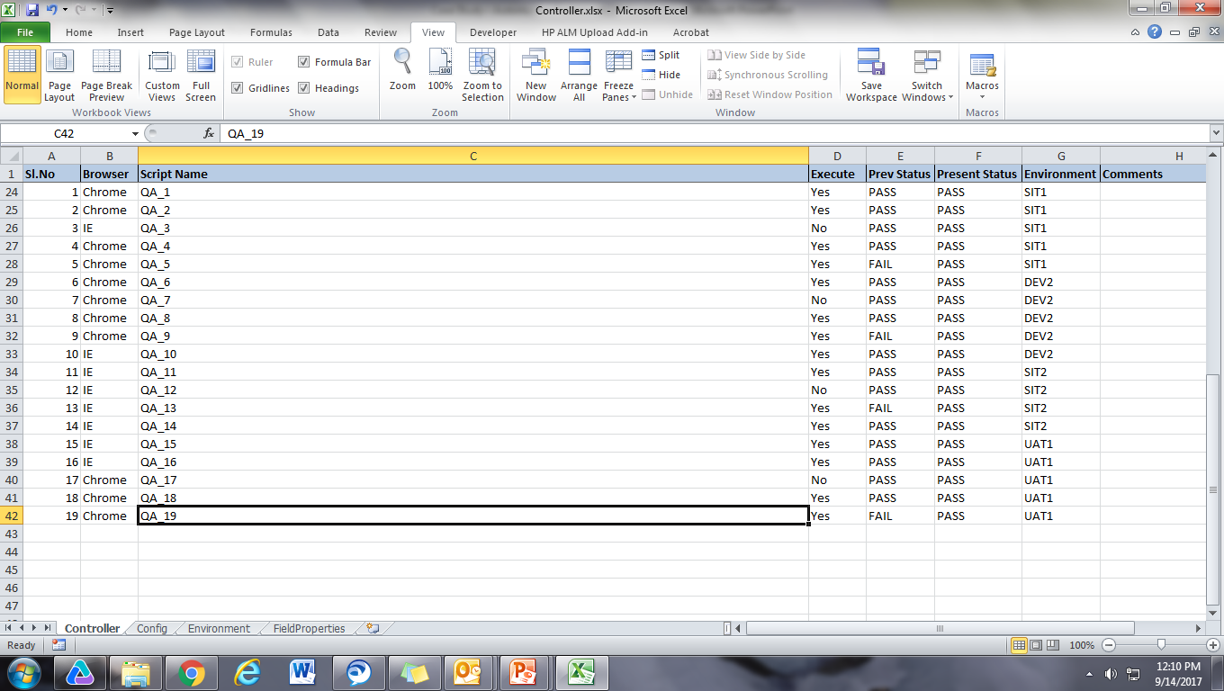
Controller Sheet

Slide 6
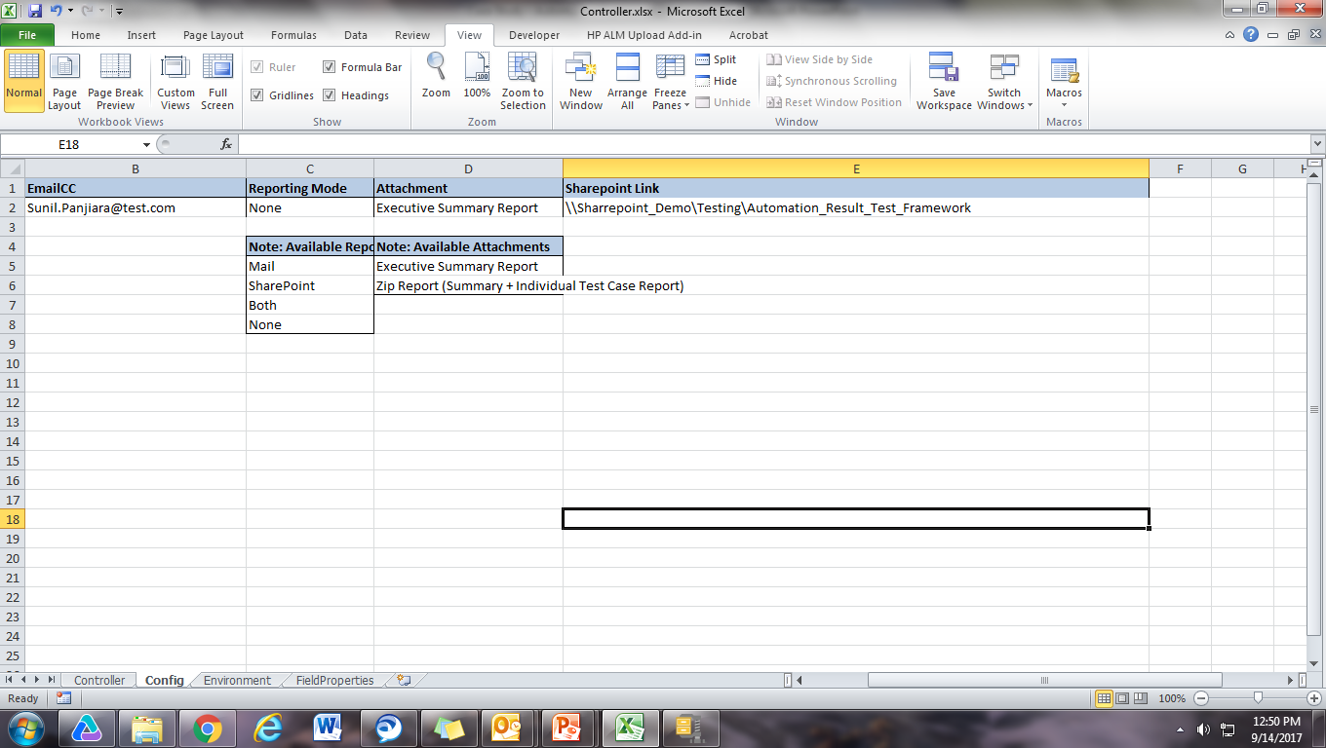
Configuration Sheet

Slide 7
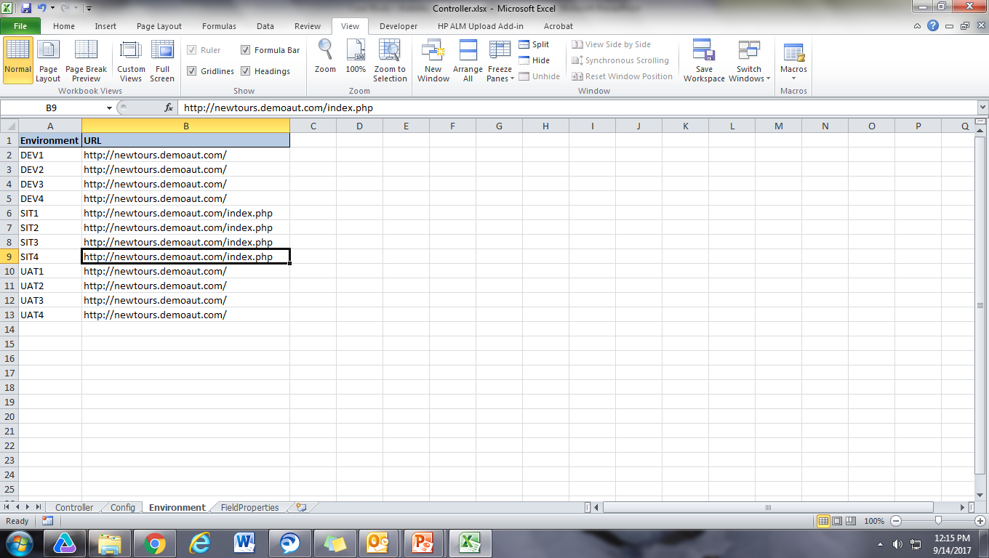
Environment Sheet

Slide 8
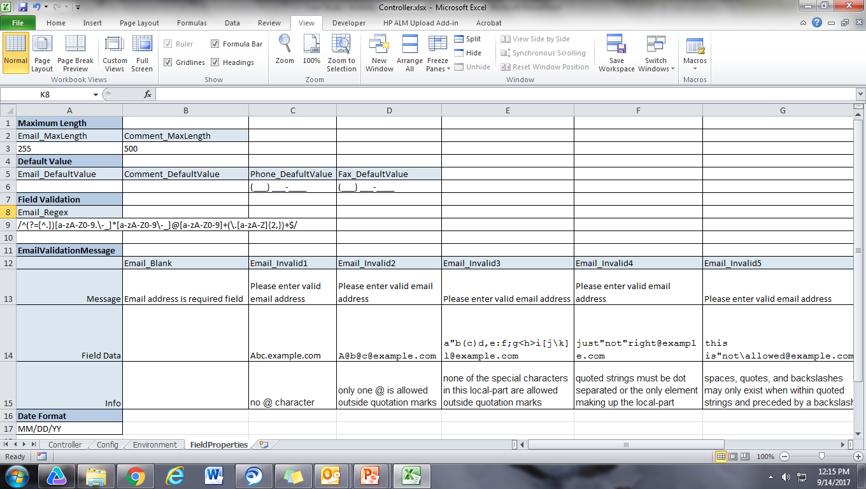
Field Properties

Slide 9
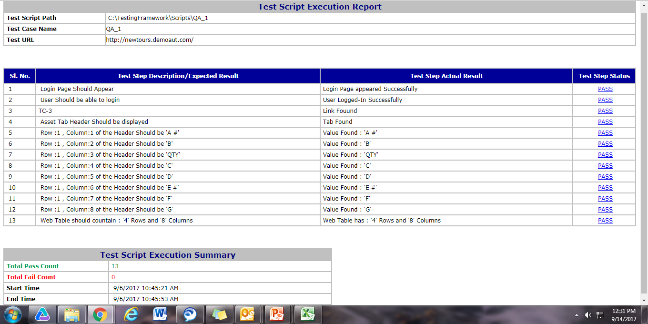
Auto Generated Test Report

Slide 10
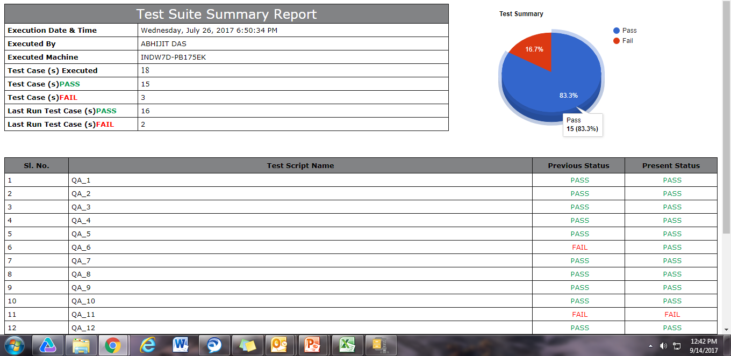
Executive Summary Report

Slide 11
Thank You

